Slide 1
Heaps
Last time
  Solving recurrences
Today
  Heaps

Slide 2
Reviews: Tree
Tree
  Rooted tree
    parent, child, sibling, ancestor
Binary tree
  Left child, right child
Some concepts
  Height
  Depth
  Level
    Level(n)= Height(root)-depth(n)

Slide 3
Heap Definition
A heap is
  An essentially complete binary tree which satisfies heap property.
Binary tree
Essentially complete binary tree
Heap property
  max-heap
    The value (key) of each node in the heap is greater than or equal to the values (keys) of its children, if any.
  min-heap
    The value (key) of each node in the heap is less than or equal to the values (keys) of its children, if any.

Slide 4
An essentially complete binary tree

Slide 5
A max-heap
12
7
9
2
7
5
4
3
1
2

Slide 6
A heap can be represented as an array
1
12
2
3
7
9
4
5
6
2
7
7
5
4
8
9
10
3
1
2
1 2 3 4 5 6 7 8 9 10
12 | 7 | 9 | 4 | 7 | 5 | 2 | 3 | 1 | 2

Slide 7

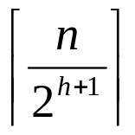
Some important properties of heaps
Given a node A[i]
  It’s parent is A[i/2], if i>1.
  It’s left child is A[2*i], if 2*i<=n.
  It’s right child is A[2*i+1], if 2*i+1<=n.
The height of a heap containing n nodes is
There are at most nodes with height h

Slide 8
Methods of class MaxHeap
Class MaxHeap {
int A[];
int n;
public void heapify(int i);
public void increaseKey(int i, int key);
public int maximum();
public int extractMax();
public void insert(int key);
public void buildHeap();
public void heapSort();
}

Slide 9
Heapify
Assume that the left and right subtrees of A[i] are already max-heaps
A[i] may be less than its children a violation
Goal: Make the subtree rooted at index i a max-heap
Application
  Call heapify(i) when the value of A[i] is decreased
heapify(int i) // also called sift-down
{
int largest = i;
int parent, lchild, rchild;
do {
parent = largest;
lchild = 2*parent;
if (lchild <= n && A[lchild]>A[largest])
largest = lchild;
rchild = lchild++;
if (rchild <= n && A[rchild]>A[largest])
largest = rchild;
swap(A[parent], A[largest]);
} while (parent != largest);
}
Cost?

Slide 10
Example
A[1] is changed from 12 to 3
12
7
9
2
7
5
4
3
1
2

Slide 11
Example
3
7
9
2
7
5
4
3
1
2
Call heapify(1)

Slide 12
Example
9
7
3
2
7
5
4
3
1
2

Slide 13
Example
9
7
5
2
7
3
4
3
1
2

Slide 14
increaseKey
public void inreaseKey(int i, int key)
{
int cur = i;
int parent;
A[cur] = key;
do {
parent = cur/2;
if (parent > 0 && A[cur]>A[parent]){
swap(A[cur], A[parent]);
cur = parent;
} else
break;
} while(1);
}
Cost?

Slide 15
Example: increaseKey
9
7
5
2
7
3
4
3
1
2
2 is changed to 8

Slide 16
Example: increaseKey
9
7
5
2
7
3
4
3
1
8

Slide 17
Example: increaseKey
9
7
5
2
8
3
4
3
1
7

Slide 18
Example: increaseKey
9
8
5
2
7
3
4
3
1
7

Slide 19
maximum
int maximum()
{
return A[1];
}

Slide 20
extractMax
int extractMax ()
{
int max = A[1];
A[1] = A[n];
n = n-1; // change heap size
heapify(1);
return max;
}

Slide 21
insert
insert(int key)
{
n = n+1; // change heap size
A[n] = -;
increaseKey(n, key);
}

Slide 22
Efficiency
Class MaxHeap {
int T[];
int n;
public void heapify(int i); // O(lg n)
public void increseKey (int i); // O(lg n)
public int maximum(); // Θ(1)
public int extractMax(); // O(lg n)
public void insert(int key); // O(lg n)
public void buildHeap(); // O(n)
public void heapSort(); // O(n lgn)
}

Slide 23
slowBuildMaxHeap
void slowBuildHeap()
{
for (i=2; i<=n; i++)
insert(A[i]);
}
Cost: homework.

Slide 24
buildHeap
What’s the idea here?
Proof
void buildHeap()
{
for (i = n/2; i >= 1; i--) {
heapify(i);
}
}

Slide 25
Analysis
heapify(int i) // also called sift-down
{
int largest = i;
int parent, lchild, rchild;
do {
parent = largest;
lchild = 2*parent;
if (lchild <= n && A[lchild]>A[largest])
largest = lchild;
rchild = lchild++;
if (rchild <= n && A[rchild]>A[largest])
largest = rchild;
swap(A[parent], A[largest]);
} while (parent != largest);
}
void buildHeap()
{
for (i=n/2; i>=1; i--) {
heapify(i);
}
}
# loop iterations <= level of node i + 1

Slide 26
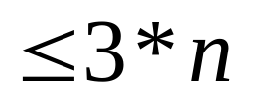
Analysis cont.
Total loop iterations:

Slide 27
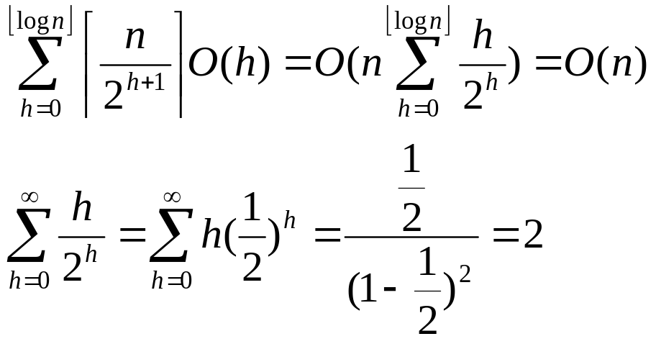
An alternative analaysis
The cost of heapify(i) for a node at height h is O(h)
The total cost is bounded by

Slide 28
heapSort
void heapSort()
{
buildHeap();
tmp=n;
for (i=n; i>=2; i--) {
exchange(A[1],A[i]);
n = i-1; // current heap size
heapify(1);
}
n=tmp;
}
Cost: O(nlgn)

Slide 29
Application: Priority Queues
  insert(S, x)
    Insert element x into S
  maximum(S)
    Return the element with the largest key
  extractMax(L)
    Remove and return the largest element
  increaseKey(S, x, k)
    Increase the value of element x’s key to the new value k

Slide 30
Implementation
Use a MaxHeap H to implement the priority queue
  insert(S, x)
    H.insert(x)
  maximum(S)
    H.maximum()
  extractMax(L)
    H.extractMax()
  increaseKey(S, x, k)
    H.increaseKey(i, k); // use an index to represent an element

